Slide 1
Human Embryology
Weeks 1-4

Slide 2
Embryology
Definition: The study of the origin and development of an organism.

Slide 3
Embryology
Ontogeny – study of complete life cycle of an organism. It consist of prenatal development and post natal growth.
•Prenatal stage- from fertilization to birth.
-zygote-embryo- fetus (studied in embryology)
•Post natal stage-growth and maturity after birth
- new born-infant –child- adult

Slide 4
Gestation period
Germinal period(zygote)- from 1st to 2nd week
•Embryonic period–from 3rd to 8th week
•Foetal period –from 9th week (3rd month) to termination of pregnancy

Slide 5
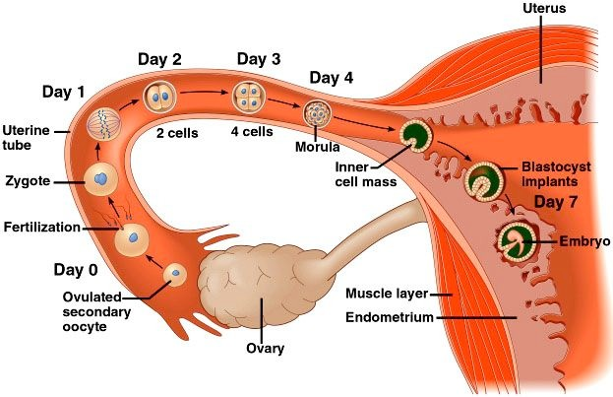
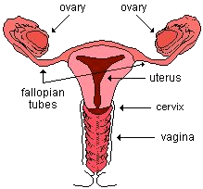
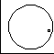
The first week of human embryonic development
Zona pellucida
Ampulla
diameter of the uterine tube 1-2 cm
diameter of the zygote 0.12 mm

Slide 6
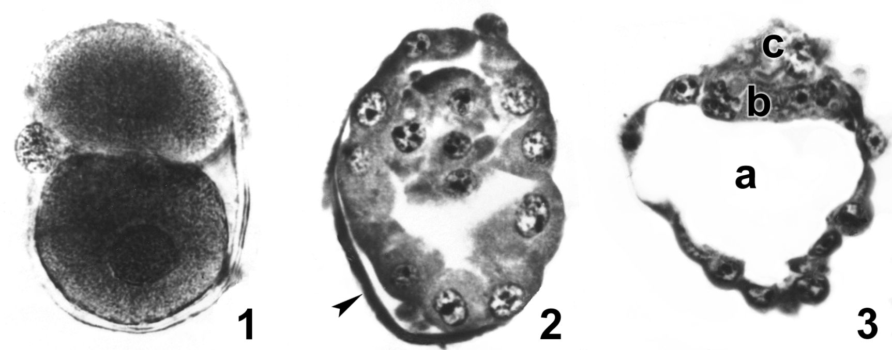
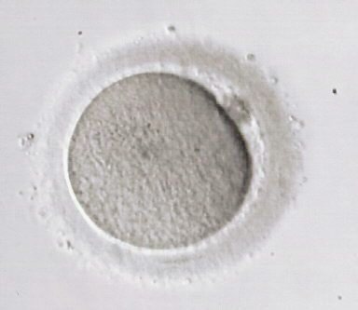
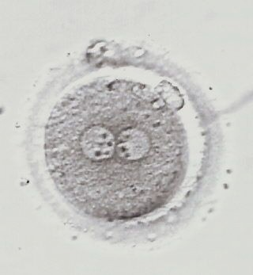
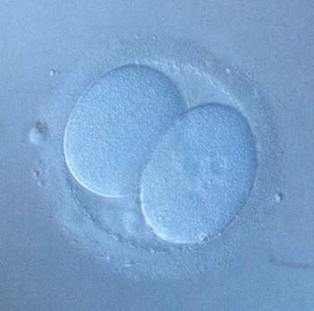
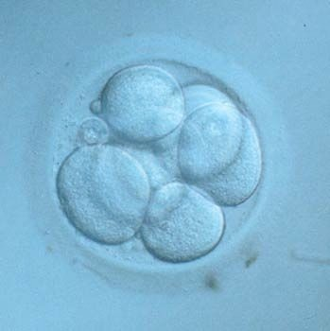
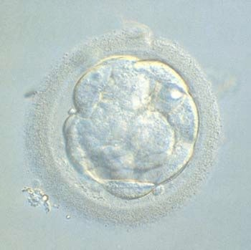
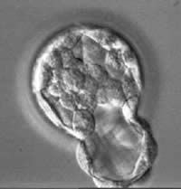
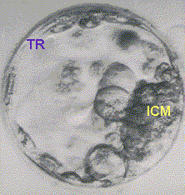
Human embryos in the first week of development
zona pellucida
inner cell mass or future embryo
trophoblast
or future placenta
2 cells~24 hours
58 cells~5days
107cells~6 days
oocyte
fertilised egg or zygote – 2 nuclei egg and sperm
2-cell stage
8-cell stage (3 days)
morula
Embryo “hatching” From the zona pellucida
blastocyst

Slide 7
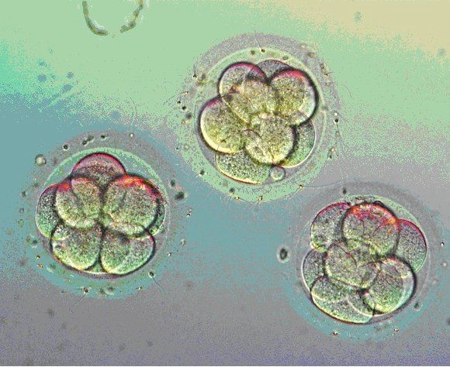
Three day old embryos

Slide 8
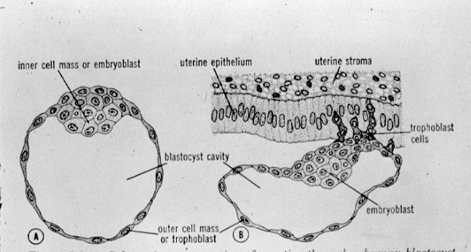
Implantation
To implant the developing embryo must pass through the uterine epithelium. This occurs about 7 days after fertilisation. The trophoblast produces human chorionic gonadotropin (hCG) which maintains the corpus luteum of the ovary which in turn produces progestesterone which maintains early pregnancy. hCG can be detected in the maternal blood and forms the basis of the early pregnancy test. Detection in urine is less sensitive.
Notes:
blood-11days, urine-12-14days.

Slide 9
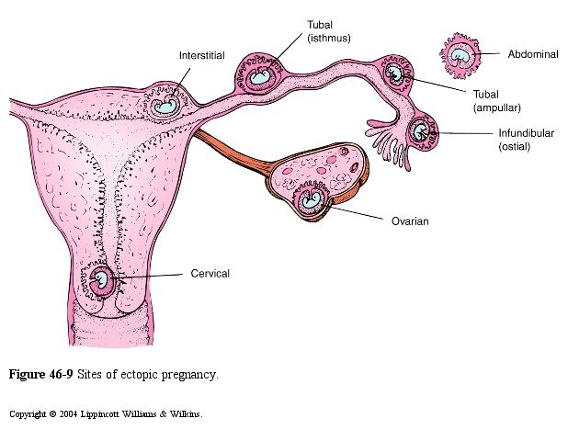
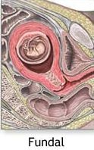
Ectopic Pregnancies
Implantation in a non- uterine site occurs at a rate of about 0.25 – 1%.
The ampulla of the uterine tube is the most common ectopic implantation site.

Slide 10
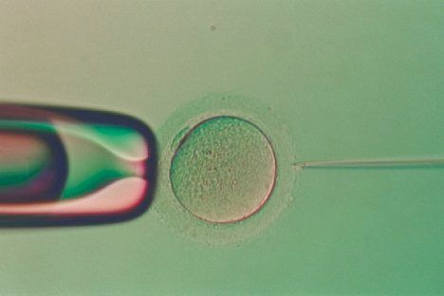
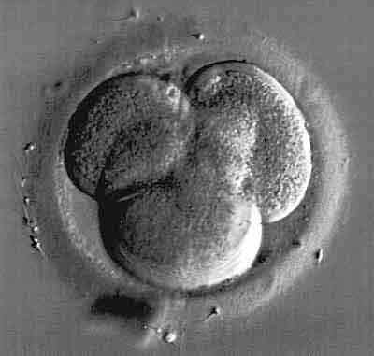
In vitro fertilisation
The process by which one or more eggs (oocytes) are fertilised outside the body. Fertilisation is either achieved by placing a droplet of washed sperm (~50,000) onto each egg or if the sperm count is low a single sperm can be injected into each egg (Intra- Cytoplasmic Sperm Injection – ICSI).
oocyte
fertilised egg (zygote)
4-cell embryo
Embryos can be placed into the uterus at the 6-8 cell stage (3-days culture) but some clinics culture the embryos for 5 or 6 days to ensure healthy blastocyst stage embryos are placed into the uterus.
blastocyst

Slide 11
Week 2
Implantation

Slide 12
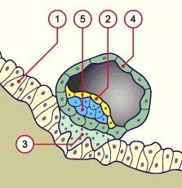
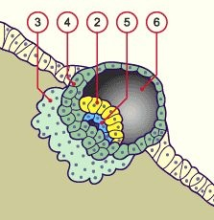
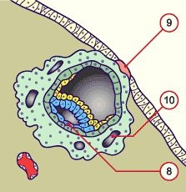
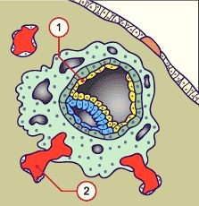
Human implantation
1 = uterine epithelium
and 5 = inner cell mass or future embryo
and 4 = trophoblast or future placenta
3 = syncytiotrophoblast
4 = cytotrophoblast
6 = yolk sac cavity 8 = amnion
9 = fibrin plug
10 = intervillous spaces
6 -7 days
7- 8 days
9 days
9-10 days
http://www.embryology.ch/francais/gnidation/etape03.html

Slide 13
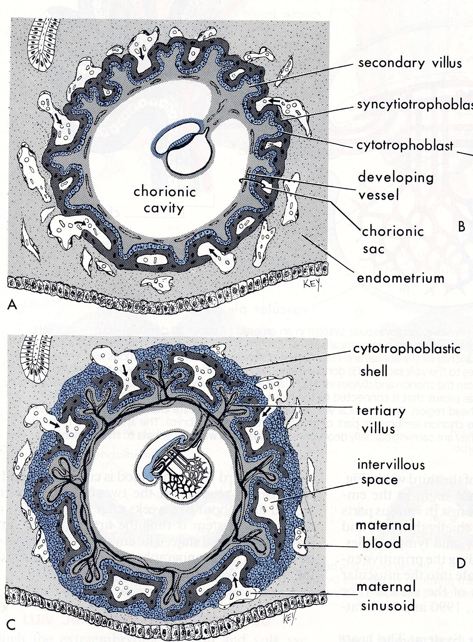
16 days gestation
21 days circulation established

Slide 14
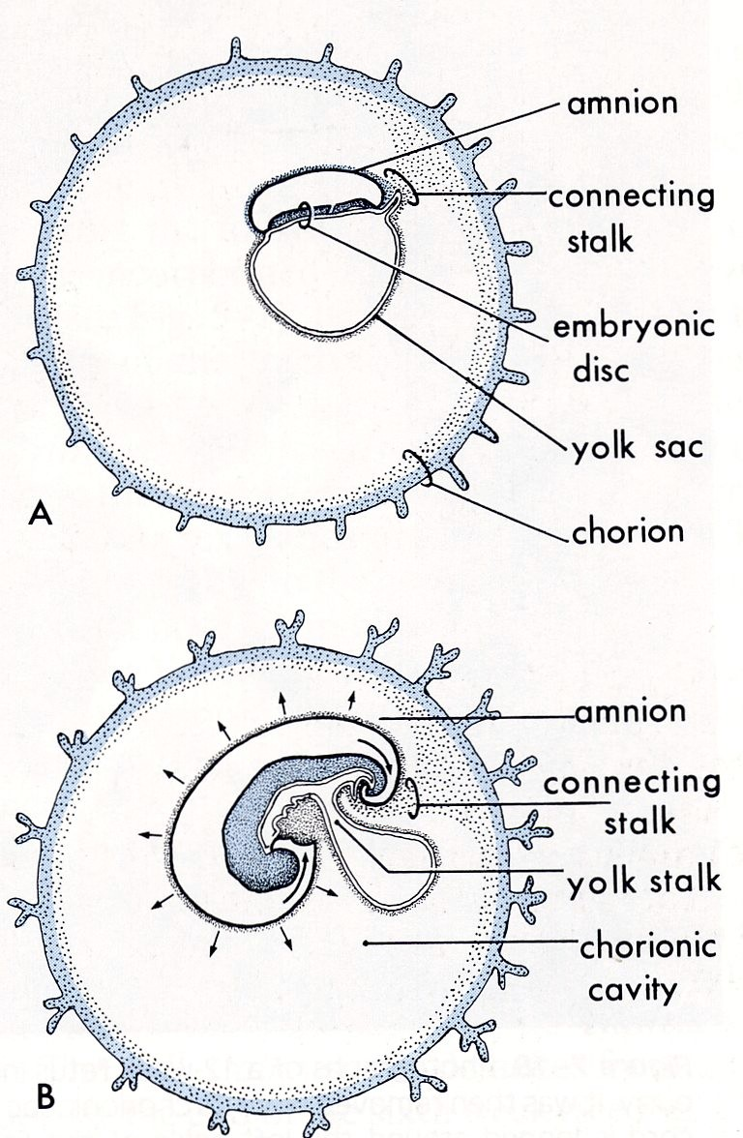
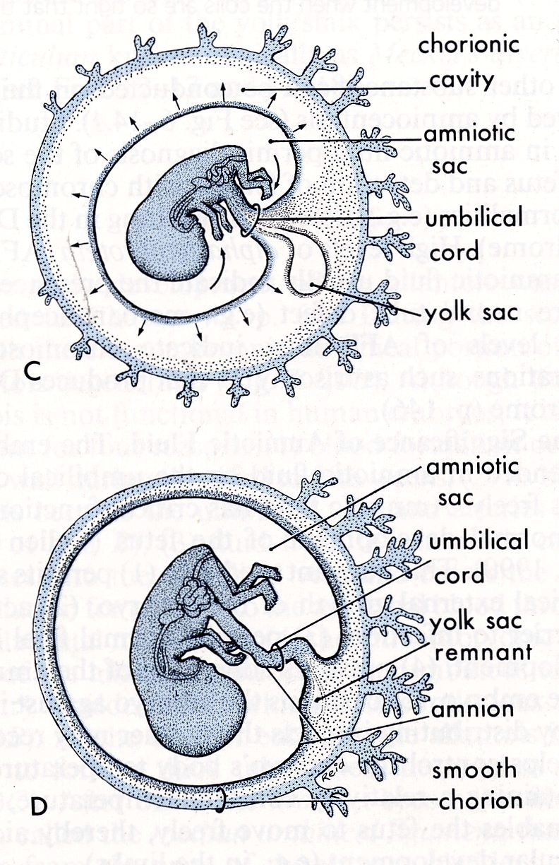
~10 weeks
~16 days
~4 weeks
~20 weeks

Slide 15
Week 3
Gastrulation
"The most important event in your life is not birth, marriage, or death, but gastrulation."- L. Wolpert.

Slide 16
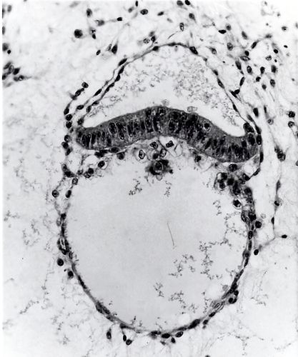
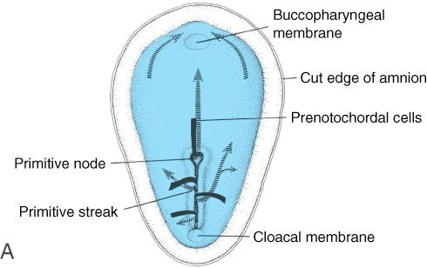
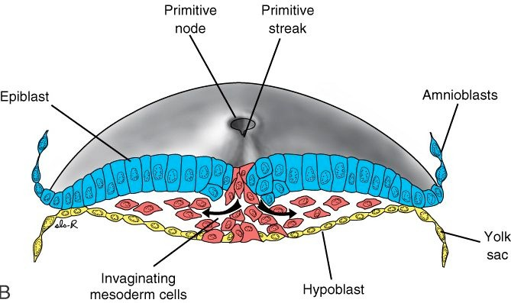
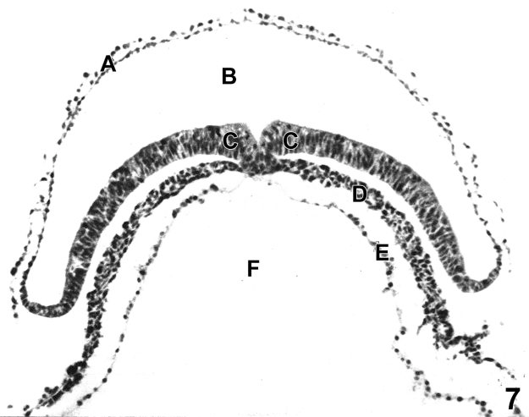
Gastrulation
The inner cell mass in the 15-16 day human embryo consists of two layers – an upper epiblast and a lower hypoblast. Gastrulation converts this bilaminar disc into three layers. An upper ectoderm, a middle mesoderm and a lower endoderm.
14-day embryo
Gastrulation in a 16-day human embryo
18-day embryo

Slide 17
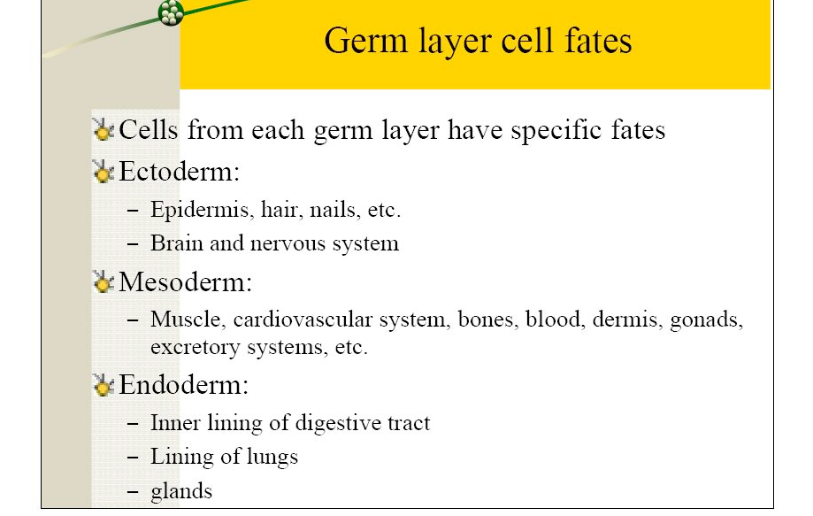
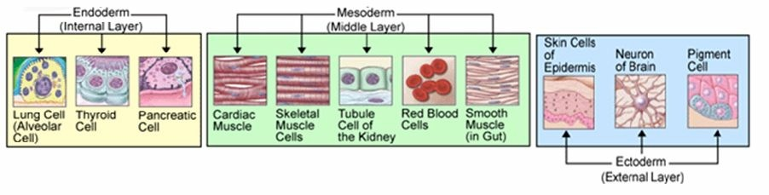

Slide 18
Week 4
Neurulation

Slide 19
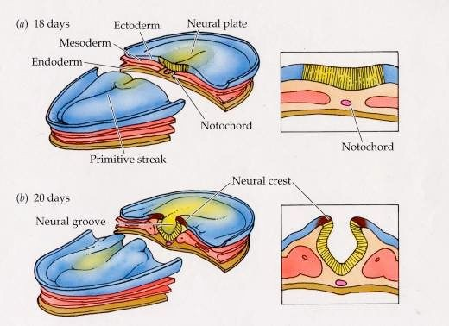
Nervous System Development in the Human Embryo
At 18 days after conception the embryo consists of 3 layers of cells: endoderm, mesoderm, and ectoderm. Thickening of the ectoderm leads to the development of the neural plate.
The neural groove begins to develop at 20 days.

Slide 20
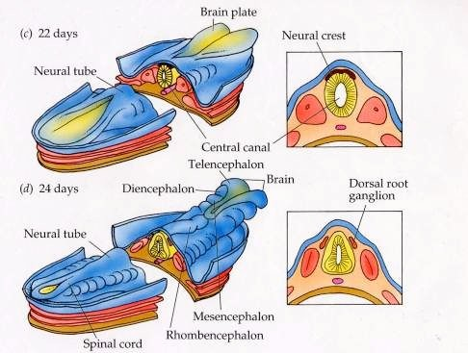
Nervous System Development in the Human Embryo
At 22 days the neural groove has closed in the middle to form the neural tube. It remains open at either end.
The anterior opening or neuropore closes day 25-26 and the posterior neuropore day 27-28.

Slide 21
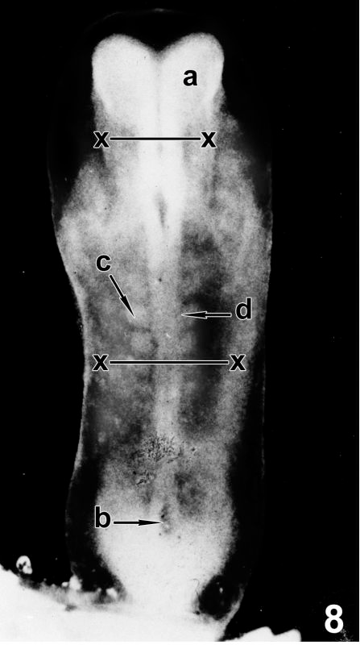
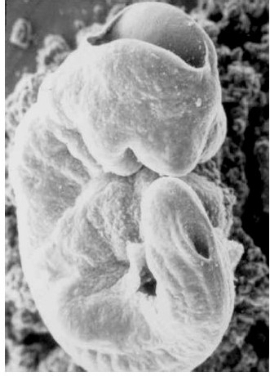
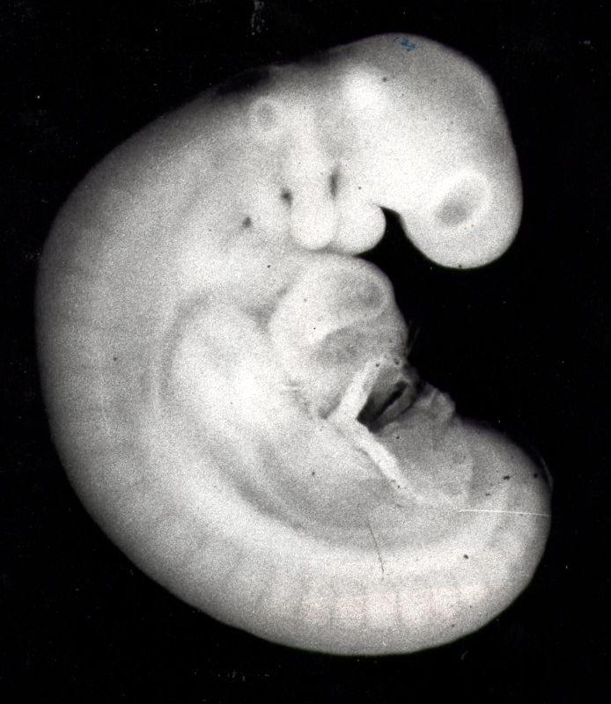
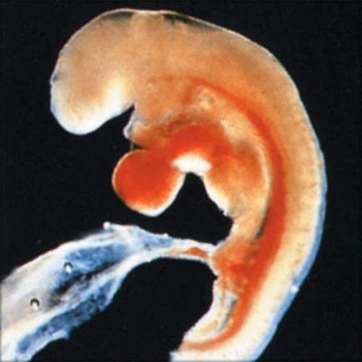
Neural tube closure
22-days
24-days
27-days~ 4mm
A 27-day embryo should have a completely closed neural tube. The heart is visible and has already started to beat.
Colour photo by Lennart Nilsson

Slide 22
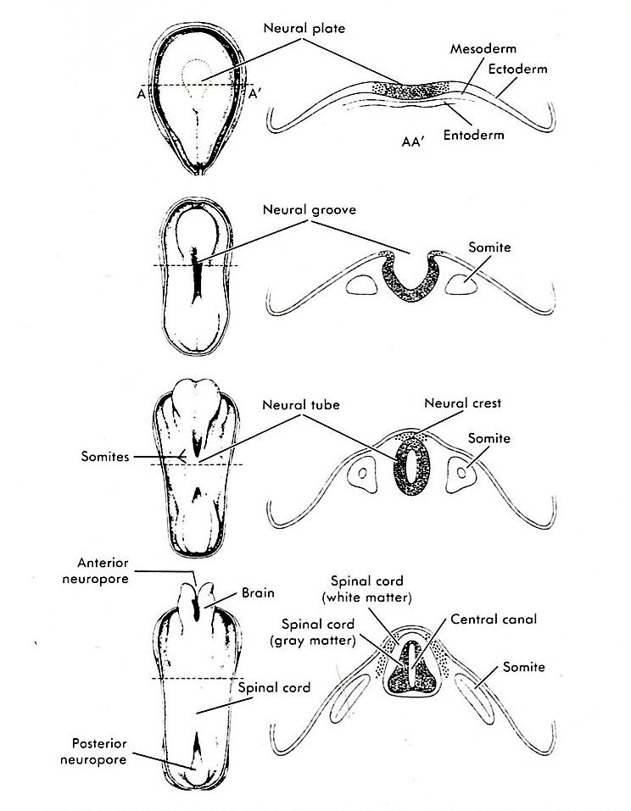
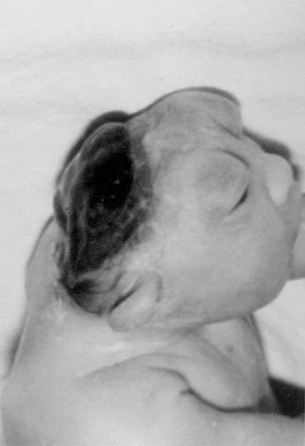
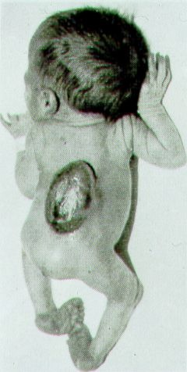
18 days
Anencephaly
www.vh.org/.../FetalYoung CNS/Images/fig03.gif
20 days
22 days
Spina Bifida
Picture from Illustrated guide to malformations of the CNS at birth by N. C. Nevin and
J. A. C. Weatherall 1983, Churchill Livingstone
24 days
Neurulation
Cowan WM The Development of the Brain Sci Am 1979; 241:112

Slide 23
Neural tube defects
The two neural tube defects spina bifida and anencephaly both have a prevalence of about 1:1000 live births.
The chances of having a child with either of these conditions can be greatly reduced by adequate folate intake. The U.S. Public Health Service in September 1992 recommended that all women of childbearing age capable of becoming pregnant consume 0.4 mg of folate daily to reduce their risk of having a pregnancy affected with spina bifida or other neural tube defects.
Use of the antiepileptic medications carbamazepine or valproic acid during early pregnancy is associated with an increased risk of
spina bifida (perhaps 10-fold increase in risk). Folate does not appear to protect against this drug-induced birth defect.

Slide 24
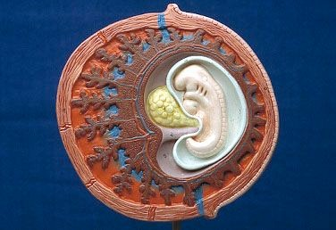
Model of 4 week embryo ~ 4 mm length

Slide 25
Weeks 5-8
Organogenic Period

Slide 26
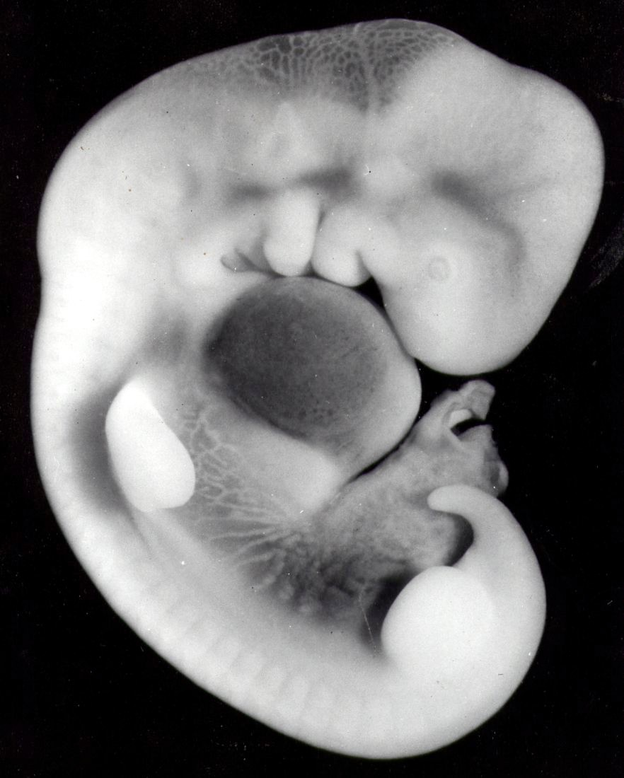
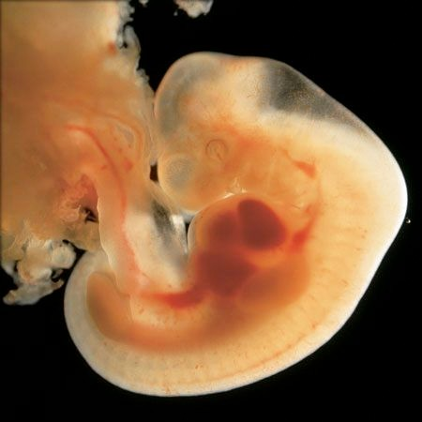
32- day human embryo ~ 8 mm CR length
Organ system development is well underway. This is a critical time for development of the heart, limbs, eyes, upper lip, intestines.

Slide 27
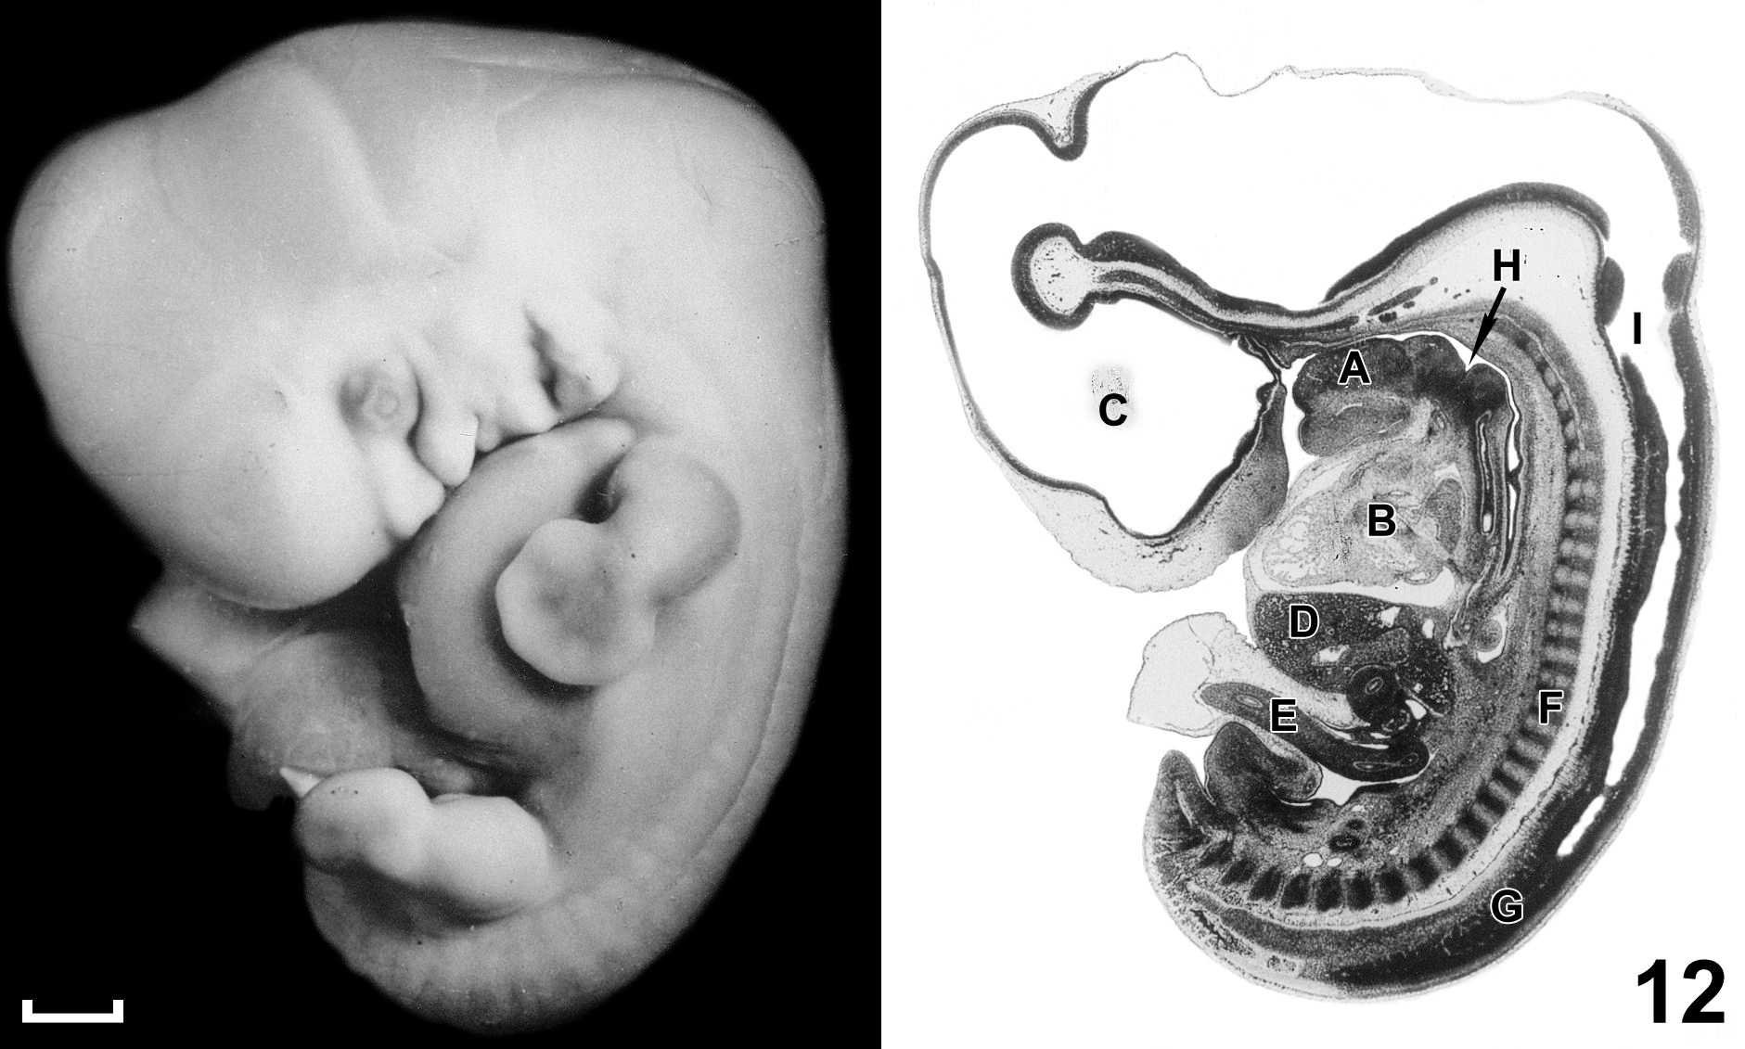
44-day embryo ~ 13 mm length
At this stage the embryo has completed much of its organogenesis. Still to be completed is the palate and external genitalia and brain development is ongoing.

Slide 28
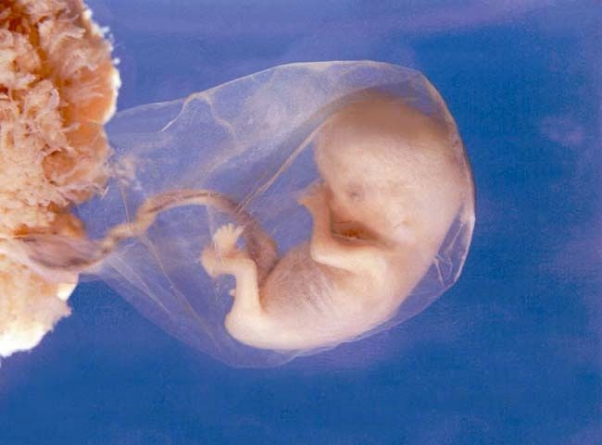
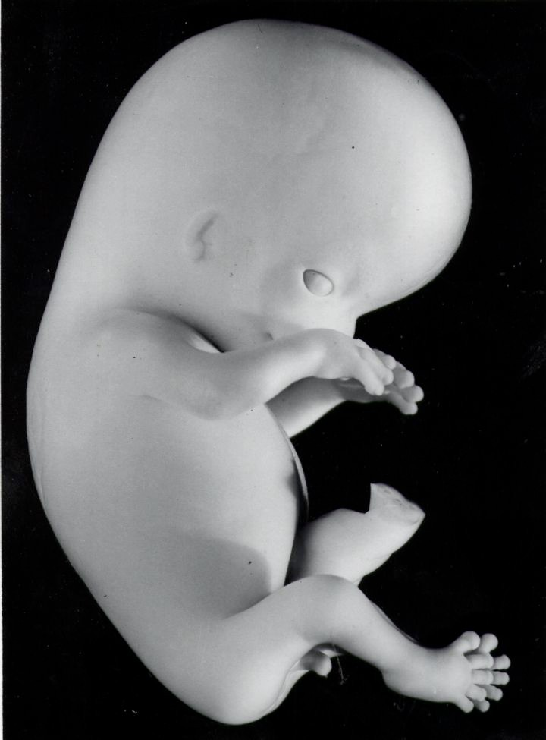
8-week human fetus ~ 3cm in length
Organogenesis is largely complete – development of the external genitalia is still incomplete. The brain is about to start an 8-week period of massive neuronal cell formation for the cerebral cortex.

Slide 29
Weeks 9-38
Fetal Period

Slide 30
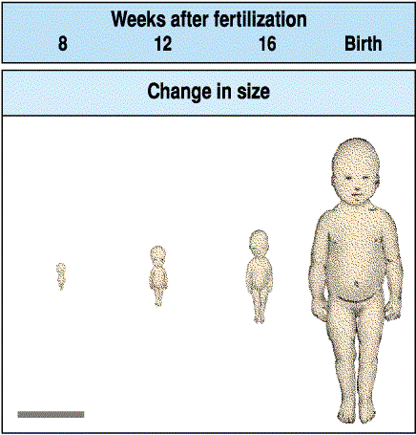
An 8-week fetus is about 4 cm in length (crown-heel), The newborn is about 50 cm (crown-heel)

Slide 31
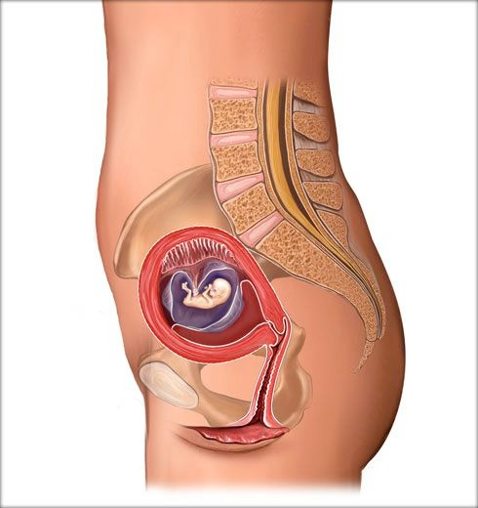
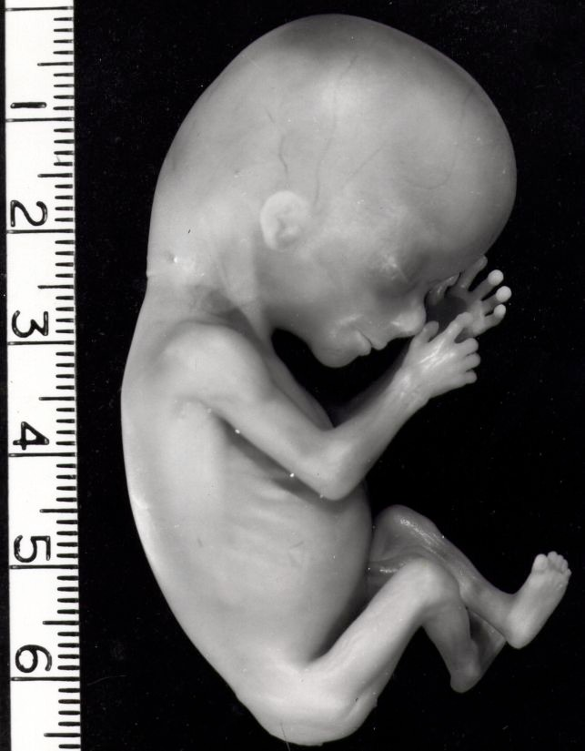
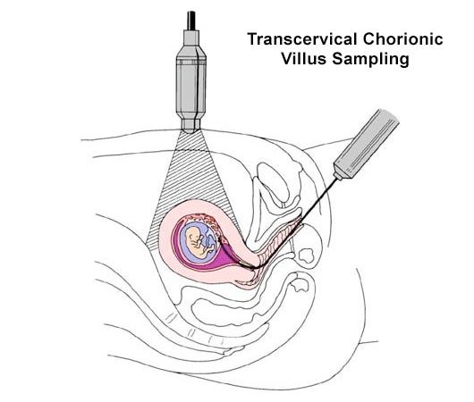
10-week human fetus ~ 6 cm in length.
Copyright ®© 2005 Nucleus Medical Art
Fetal heart beat can be monitored at this stage. Chorionic villous sampling is usually performed between 8 and 10 weeks. A small piece (villous) of the placenta is removed and cultured in the laboratory. Genetic results are usually available in ~2 weeks.

Slide 32
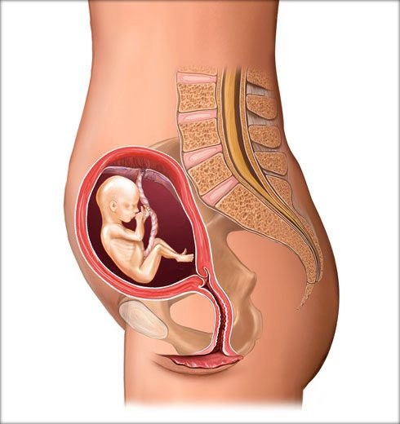


13-week human fetus ~ 10cm in length.
The fetus is surrounded by about 100 ml of amniotic fluid. Amniocentesis can be performed from about 13 to 18 weeks gestation. About 10-20 ml of fluid is removed, the fetal cells are separated and grown in culture and genetic results available in about 2 weeks. An !-fetoprotein test can be performed on the maternal blood. This protein is made by the fetus and is in higher concentrations in fetuses with neural tube defects.

Slide 33


16-week human fetus ~ 14cm in length, weight about 190 g.
An ultrasound dating scan can be given at 5-11 weeks to confirm pregnancy, exclude ectopic or molar pregnancies, confirm cardiac pulsation and measure the crown-rump length for dating. An anomaly scan is usually performed at 16-18 weeks to look for congenital malformations. Sex of the fetus can usually be determined at this stage.

Slide 34


24-week human fetus ~ 23cm in length – weight about 760g.
Head hair appears, the fetus already has a downy hair (lanugo), skin is coated with vernix – a waxy secretion of sebaceous glands. 90% of premature babies born who weigh 800 g or more will survive. For those who weigh 500 g or more there is 40-50% survival.
Problems include (a) lack of body fat – difficulty keeping warm; (b) difficulty feeding; (c) hyperbilirubinemia; (d) apnea; (e) anemia; (f) respiratory distress syndrome due to lack of lung surfactant; (g) patent ductus arteriosus; (h) retinopathy.

Slide 35


38 weeks – term - crown-rump length about 36cm, crown heel 50 cm – weight about 3500g.
Eyes reopened at about 26 weeks, at about 30 weeks skin becomes thicker and subcutaneous fat appears.

Slide 36
FINISH!

